Slide 1

Design Pattern(Creational, Structural)
Java Full Stack Program

Slide 2
DESIGN PATTERNS
A Design Pattern is a general reusable solution to a commonly occurring problem in software design.
A design pattern isn't a finished design that can be transformed directly into code. It is a description or template for how to solve a problem that can be used in many different situations.
There are three design patterns described.
They are as follows:
1)Creational
2)Structural
3)Behavioral
Java Full Stack Program

Slide 3
Creational design patterns
Creational design patterns are concerned with the way of creating/instantiating objects.
These patterns can be further categorized into
Class-creational patterns
object-creational pattern
While class-creation patterns use inheritance effectively in the instantiation process, object-creation patterns use delegation effectively to get the job done.
Java Full Stack Program

Slide 4
There are following 6 types of creational design patterns.
1. Factory Method Pattern
A Factory Pattern or Factory Method Pattern says that just define an interface or abstract class for creating an object but let the subclasses decide which class to instantiate.
In other words, subclasses are responsible to create the instance of the class.
The Factory Method Pattern is also known as Virtual Constructor.
Advantage of Factory Design Pattern
Factory Method Pattern allows the sub-classes to choose the type of objects to create.
It promotes the loose-coupling by eliminating the need to bind application-specific classes into the code.
That means the code interacts solely with the resultant interface or abstract class, so that it will work with any classes that implement that interface or that extends that abstract class.
Java Full Stack Program

Slide 5
Usage of Factory Design Pattern
When a class doesn't know what sub-classes will be required to create
When a class wants that its sub-classes specify the objects to be created.
When the parent classes choose the creation of objects to its sub-classes.
UML for Factory Method Pattern
We are going to create a Plan abstract class and concrete classes that extends the Plan abstract class. A factory class GetPlanFactory is defined as a next step.
Generate Bill class will use GetPlanFactory to get a Plan object. It will pass information (DOMESTICPLAN / COMMERCIALPLAN / INSTITUTIONALPLAN) to GetPalnFactory to get the type of object it needs.
Java Full Stack Program

Slide 6
2. Abstract Factory Pattern
Abstract Factory Pattern says that just define an interface or abstract class for creating families of related (or dependent) objects but without specifying their concrete sub-classes.
That means Abstract Factory lets a class returns a factory of classes. So, this is the reason that Abstract Factory Pattern is one level higher than the Factory Pattern.
An Abstract Factory Pattern is also known as Kit.
Advantage of Abstract Factory Pattern
Abstract Factory Pattern isolates the client code from concrete (implementation) classes.
It eases the exchanging of object families.
It promotes consistency among objects.
Java Full Stack Program

Slide 7
Usage of Abstract Factory Pattern
When the system needs to be independent of how its object are created, composed, and represented.
When the family of related objects has to be used together, then this constraint needs to be enforced.
When you want to provide a library of objects that does not show implementations and only reveals interfaces.
When the system needs to be configured with one of a multiple family of objects.
UML for Abstract Factory Pattern
We are going to create a Bank interface and a Loan abstract class as well as their sub-classes.
Then we will create Abstract Factory class as next step.
Then after we will create concrete classes, Bank Factory, and Loan Factory that will extends Abstract Factory class
After that, Abstract Factory Pattern Example class uses the Factory Creator to get an object of Abstract Factory class.
See the diagram carefully which is given below:
Java Full Stack Program

Slide 8
3. Singleton design pattern
Singleton Pattern says that just "define a class that has only one instance and provides a global point of access to it".
In other words, a class must ensure that only single instance should be created and single object can be used by all other classes.
There are two forms of singleton design pattern
Early Instantiation: creation of instance at load time.
Lazy Instantiation: creation of instance when required.
Advantage of Singleton design pattern
Saves memory because object is not created at each request.
Only single instance is reused again and again.
Java Full Stack Program

Slide 9
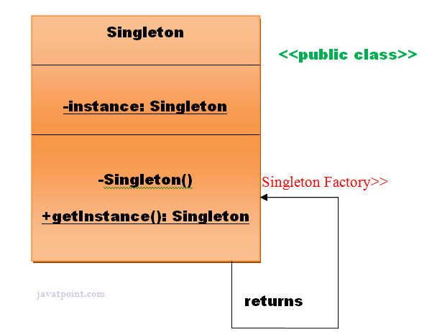
Usage of Singleton design pattern
Singleton pattern is mostly used in multi-threaded and database applications.
It is used in logging, caching, thread pools, configuration settings etc.
Uml of Singleton design pattern
Java Full Stack Program

Slide 10
4. Prototype Design Pattern
Prototype Pattern says that cloning of an existing object instead of creating new one and can also be customized as per the requirement.
This pattern should be followed, if the cost of creating a new object is expensive and resource intensive.
Advantage of Prototype Pattern
The main advantages of prototype pattern are as follows:
It reduces the need of sub-classing.
It hides complexities of creating objects.
The clients can get new objects without knowing which type of object it will be.
It lets you add or remove objects at runtime.
Usage of Prototype Pattern
When the classes are instantiated at runtime.
When the cost of creating an object is expensive or complicated.
When you want to keep the number of classes in an application minimum.
When the client application needs to be unaware of object creation and representation.
Java Full Stack Program

Slide 11
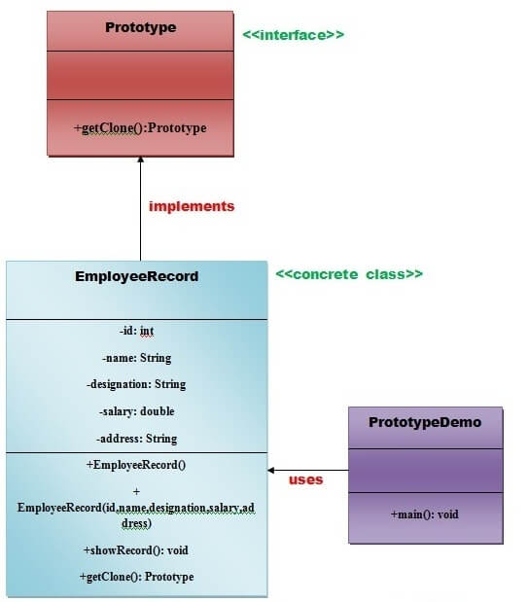
UML for Prototype Pattern
We are going to create an interface
Prototype that contains
a method getClone() of Prototype type.
Then, we create a concrete
class Employee Record which
implements Prototype interface
that does the cloning of
Employee Record object.
Prototype Demo class will uses this
concrete class Employee Record.
Java Full Stack Program

Slide 12
5. Builder Design Pattern
Builder Pattern says that "construct a complex object from simple objects using step-by-step approach"
It is mostly used when object can't be created in single step like in the de-serialization of a complex object.
Advantage of Builder Design Pattern
The main advantages of Builder Pattern are as follows:
It provides clear separation between the construction and representation of an object.
It provides better control over construction process.
It supports to change the internal representation of objects.
Java Full Stack Program

Slide 13
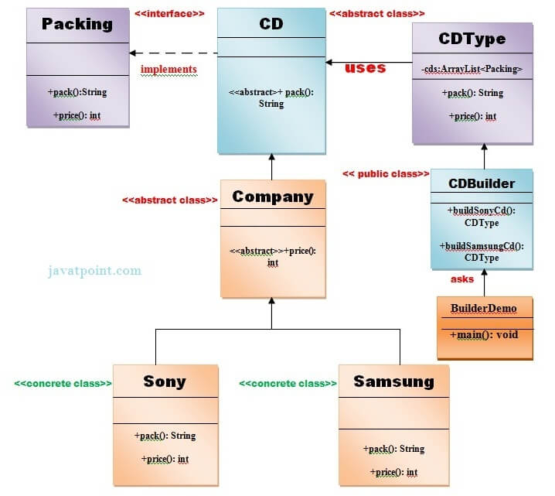
UML for Builder Pattern Example
Java Full Stack Program

Slide 14
6. Object Pool Pattern
Mostly, performance is the key issue during the software development and the object creation, which may be a costly step.
Object Pool Pattern says that " to reuse the object that are expensive to create".
Basically, an Object pool is a container which contains a specified amount of objects. When an object is taken from the pool, it is not available in the pool until it is put back.
Objects in the pool have a lifecycle: creation, validation and destroy.
A pool helps to manage available resources in a better way.
There are many using examples: especially in application servers there are data source pools, thread pools etc.
Java Full Stack Program

Slide 15
Advantage of Object Pool design pattern
It boosts the performance of the application significantly.
It is most effective in a situation where the rate of initializing a class instance is high.
It manages the connections and provides a way to reuse and share them.
It can also provide the limit for the maximum number of objects that can be created.
Usage:
When an application requires objects which are expensive to create. Eg: there is a need of opening too many connections for the database then it takes too longer to create a new one and the database server will be overloaded.
When there are several clients who need the same resource at different times.
Java Full Stack Program

Slide 16
Structural design patterns
Structural design patterns are concerned with how classes and objects can be composed, to form larger structures.
The structural design patterns simplifies the structure by identifying the relationships.
These patterns focus on, how the classes inherit from each other and how they are composed from other classes.
Types of structural design patterns
There are following 7 types of structural design patterns.
Adapter Pattern:
Adapting an interface into another according to client expectation.
Bridge Pattern:
Separating abstraction (interface) from implementation.
Java Full Stack Program

Slide 17
3. Composite Pattern
Allowing clients to operate on hierarchy of objects.
4. Decorator Pattern
Adding functionality to an object dynamically.
5. Facade Pattern
Providing an interface to a set of interfaces.
6.Flyweight Pattern
Reusing an object by sharing it.
7.proxy Pattern
Representing another object.
Java Full Stack Program

Slide 18
1. Adapter Pattern
An Adapter Pattern says that just "converts the interface of a class into another interface that a client wants".
In other words, to provide the interface according to client requirement while using the services of a class with a different interface.
The Adapter Pattern is also known as Wrapper.
Advantage of Adapter Pattern
It allows two or more previously incompatible objects to interact.
It allows reusability of existing functionality.
Usage of Adapter pattern:
When an object needs to utilize an existing class with an incompatible interface.
When you want to create a reusable class that cooperates with classes which don't have compatible interfaces.
Java Full Stack Program

Slide 19
Example of Adapter Pattern
Let's understand the example of adapter design pattern by the above UML diagram.
UML for Adapter Pattern:
There are the following specifications for the adapter pattern:
Target Interface: This is the desired interface class which will be used by the clients.
Adapter class: This class is a wrapper class which implements the desired target interface and modifies the specific request available from the Adaptee class.
Adaptee class: This is the class which is used by the Adapter class to reuse the existing functionality and modify them for desired use.
Client: This class will interact with the Adapter class.
Java Full Stack Program

Slide 20
2. Bridge Pattern
A Bridge Pattern says that just "decouple the functional abstraction from the implementation so that the two can vary independently".
The Bridge Pattern is also known as Handle or Body.
Advantage of Bridge Pattern
It enables the separation of implementation from the interface.
It improves the extensibility.
It allows the hiding of implementation details from the client.
Usage of Bridge Pattern
When you don't want a permanent binding between the functional abstraction and its implementation.
When both the functional abstraction and its implementation need to extended using sub-classes.
It is mostly used in those places where changes are made in the implementation does not affect the clients.
Java Full Stack Program

Slide 21
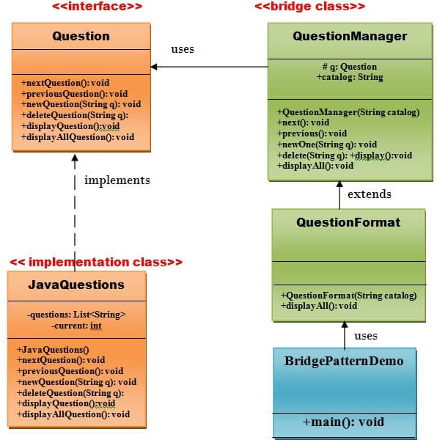
UML for Bridge Pattern:
Java Full Stack Program

Slide 22
3. Composite Pattern
A Composite Pattern says that just "allow clients to operate in generic manner on objects that may or may not represent a hierarchy of objects".
Advantage of Composite Design Pattern
It defines class hierarchies that contain primitive and complex objects.
It makes easier to you to add new kinds of components.
It provides flexibility of structure with manageable class or interface.
Usage of Composite Pattern
It is used:
When you want to represent a full or partial hierarchy of objects.
When the responsibilities are needed to be added dynamically to the individual objects without affecting other objects. Where the responsibility of object may vary from time to time.
Java Full Stack Program

Slide 23
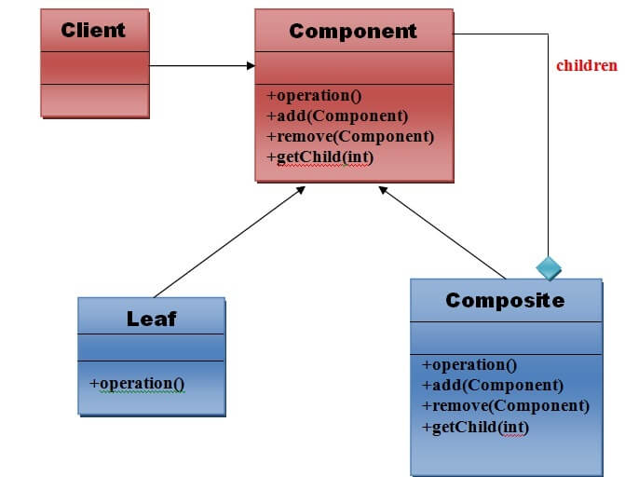
UML for Composite Pattern
1. component
Declares interface for objects in
composition.
2. Leaf
Represents leaf objects in composition.
A leaf has no children.
3. Composite
Defines behavior for components
having children.
4.Client
Manipulates objects in the composition
through the component interface.
Java Full Stack Program

Slide 24
4. Decorator Pattern
A Decorator Pattern says that just "attach a flexible additional responsibilities to an object dynamically".
In other words, The Decorator Pattern uses composition instead of inheritance to extend the functionality of an object at runtime.
The Decorator Pattern is also known as Wrapper.
Advantage of Decorator Pattern
It provides greater flexibility than static inheritance.
It enhances the extensibility of the object, because changes are made by coding new classes.
It simplifies the coding by allowing you to develop a series of functionality from targeted classes instead of coding all of the behavior into the object.
Java Full Stack Program

Slide 25
5. Facade Pattern
A Facade Pattern says that just "just provide a unified and simplified interface to a set of interfaces in a subsystem, therefore it hides the complexities of the subsystem from the client".
In other words, Facade Pattern describes a higher-level interface that makes the sub-system easier to use.
Practically, every Abstract Factory is a type of Facade.
Advantage of Facade Pattern
It shields the clients from the complexities of the sub-system components.
It promotes loose coupling between subsystems and its clients.
Usage of Facade Pattern:
It is used:
When you want to provide simple interface to a complex sub-system.
When several dependencies exist between clients and the implementation classes of an abstraction.
Java Full Stack Program

Slide 26
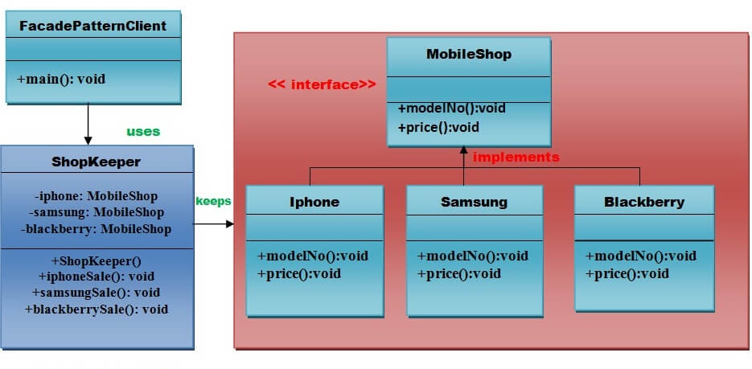
UML for Facade Pattern:
Java Full Stack Program

Slide 27
6. Flyweight Pattern
A Flyweight Pattern says that just "to reuse already existing similar kind of objects by storing them and create new object when no matching object is found".
Advantage of Flyweight Pattern
It reduces the number of objects.
It reduces the amount of memory and storage devices required if the objects are persisted
Usage of Flyweight Pattern
When an application uses number of objects
When the storage cost is high because of the quantity of objects.
When the application does not depend on object identity.
Java Full Stack Program

Slide 28
7. Proxy Pattern
Simply, proxy means an object representing another object.
According to GoF, a Proxy Pattern "provides the control for accessing the original object".
So, we can perform many operations like hiding the information of original object, on demand loading etc.
Proxy pattern is also known as Surrogate or Placeholder.
Advantage of Proxy Pattern
It provides the protection to the original object from the outside world.
Java Full Stack Program

Slide 29
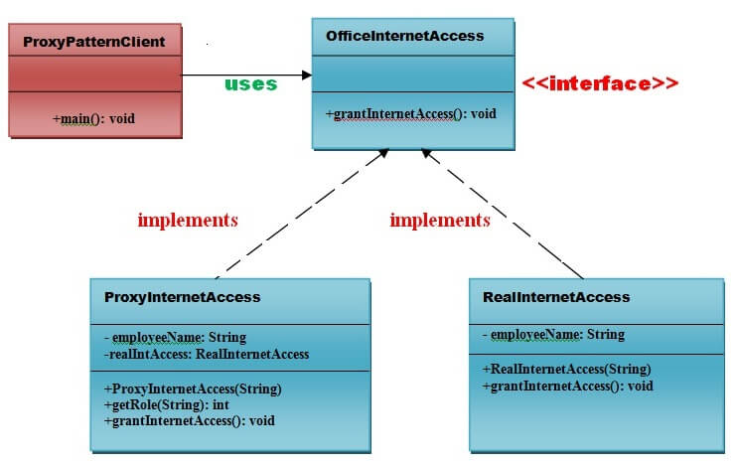
UML for Proxy Pattern:
Java Full Stack Program

Slide 30
THANK YOU
Java Full Stack Program

